Slide 1
Predicting the areas to start an Indian Restaurant in Toronto
Ankush lakkanna

Slide 2
The interest of starting a Restaurant
Toronto is one of the most developed cities in the world.
A lot of people have aspirations to start a business of their own in a city like Toronto.
For Restaurants, the area surrounding it matters a lot.
The right area can help create a loyal customer base that will provide a lot of profit for the restaurant.
It is a tedious task looking around each neighborhood in search for the right neighborhood and that is where data science comes in.
This project will be useful for the people of India who wish to move to Toronto to start a restaurant of their own.
This project can also be tweaked to help people with other interests as well.

Slide 3
Data Acquisition and cleaning
We obtain the list of neighborhoods using https://en.wikipedia.org/wiki/List_of_postal_codes_of_Canada:_M
For geospatial coordinates we use http://cocl.us/Geospatial_data
Ethnicity data is obtained from https://en.wikipedia.org/wiki/Demographics_of_Toronto
List of neighborhoods contains the postcode, borough and the neighborhood.
Geospatial data consists of postcode, latitude and longitude.
Ethnicity data consists of the ethnicity with percentage in each neighborhood

Slide 4
Data Acquisition and cleaning
Rows that do not contain Neighborhood names are assigned Borough names.
Rows that do not contain Borough names are eliminated.
Rows that contain the same post code are merged.
Using the postcode, the geospatial data is merged with the neighborhood data
We have 103 rows and 5 columns.

Slide 5
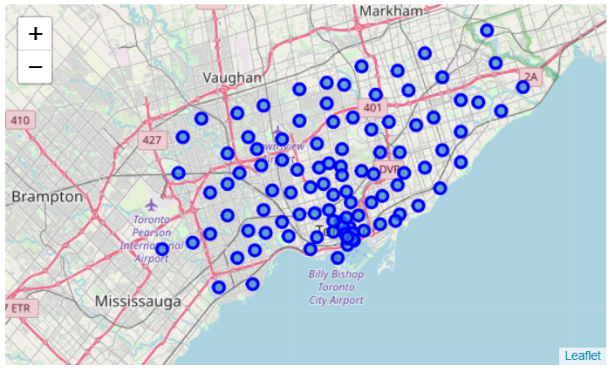
Neighborhoods in Toronto
Now that we have all the names of the neighborhoods, boroughs, postcodes, latitudes and longitudes, lets plot the neighborhoods using the folium package.
Folium provides interactive maps.We can zoom in and out and we can move the map around.

Slide 6
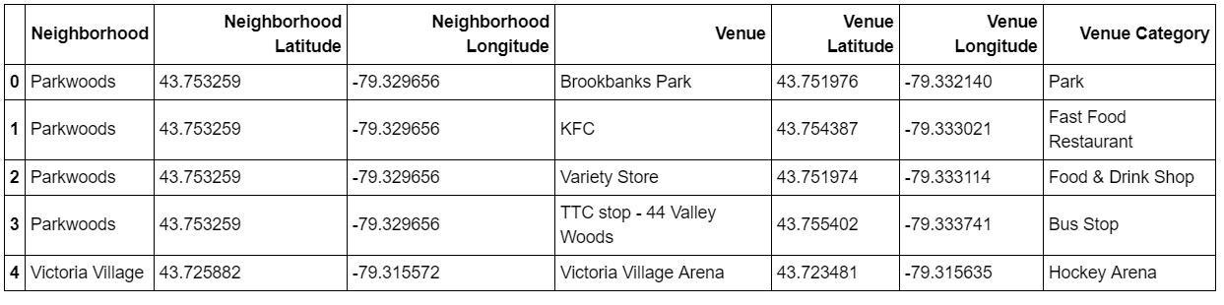
Foursquare API
Using the foursquare API we get the venues and venues categories in each neighborhood

Slide 7
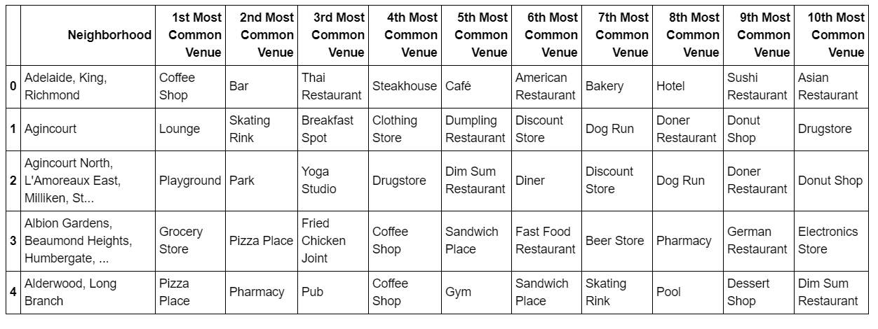
Top 10 venues
Now that we have all the venues for each neighborhood, we then create a dataset which contains the top 10 most common venues for each neighborhood.
The common venues are based on the venue category and not by the name of the venue

Slide 8
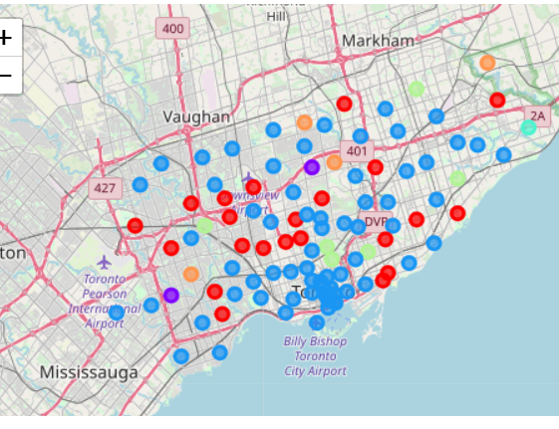
Predictive Modelling
Used K Means to cluster similar neighborhoods together
Plotted the result on a folium map.
Based on the top 10 venues of each neighborhood

Slide 9
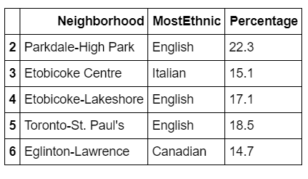
Ethnicity Analysis
Used a dataset that contains the ethnicity of each electoral area. It also consisted of a percentage of the most ethnic group in each area.

Slide 10
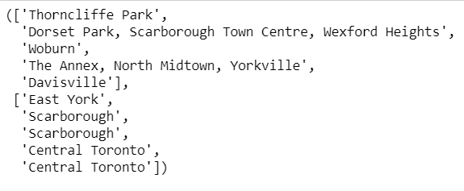
Ethnicity Analysis
Checked the boroughs where the most common venues are Indian Restaurant.
Printed out the neighborhood and boroughs to get an idea of the areas to avoid in order to get a loyal customer base

Slide 11
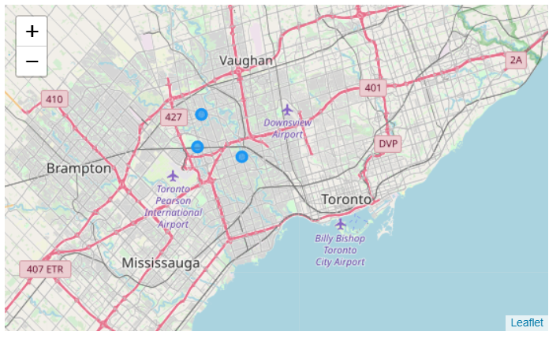
Target Neighborhoods
Found that Etobicoke North was the best area to start a restaurant in.
There were no popular Indian Restaurants in the area.
Had a high Indian Population.
Plotted the neighborhoods in Etobicoke north on a folium map.

Slide 12
Conclusion and Future Direction
Built a program that can help Indians identify the areas to start an Indian Restaurant in.
Can be tweaked to help other people to start a business of their own
With a more detailed ethnicity dataset we can improve the accuracy of the program
We can also rank the neighborhoods from best to worst with such a dataset

